Slide 1
Alphabet Aerobics
Take out your list* of words.
Create body shapes for each letter to spell each word:
Tall letters = stand with arms above head
b, d, f, h, k, l, t
Short letters = bend knees with arms out in front
a, c, e, i, m, n, o, r, s, u, v, w, x, z
Letters with tails = touch toes
g, j, p, q, y

Slide 2
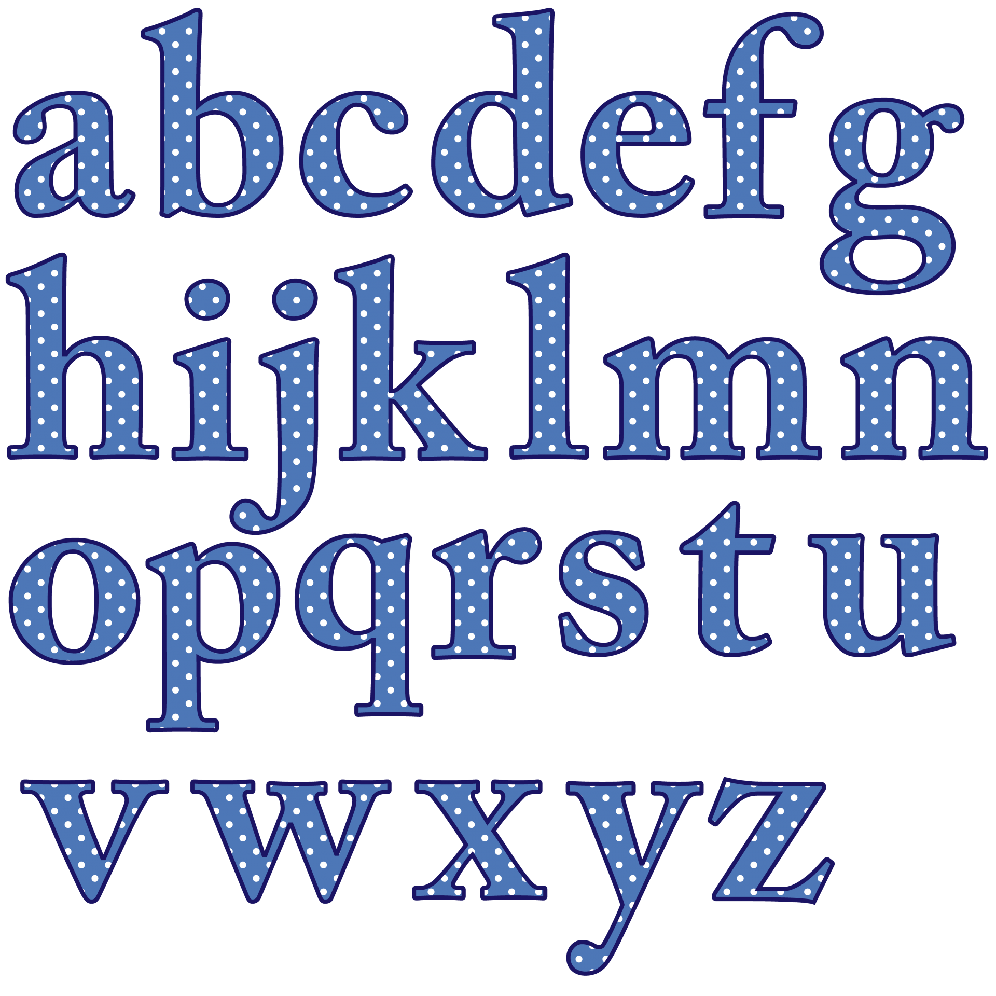

Slide 3
Air Writing
Take out your list of words.
Using your pointer finger, practice writing each word in the air in front of you.

Slide 4
Interruptions
Read the text aloud and interrupt your reading when you come across these text elements by doing the following movements:
! = Jump in the air
. = Sit down
, = Breath in deeply, exhale slowly
: = Both hands above your head
? = Spin in a circle
Capital letter = Stand up

Slide 5
Interruptions
! = Jump
. = Sit
, = Inhale, exhale
: = Hands above head
? = Spin around
Capital = Stand

